Slide 1
Image Interpretation Revision

Slide 2
Discussion of an Image
How meanings are conveyed through the use of visual conventions

Slide 3
Visual Conventions
Texts convey meanings by employing visual codes and conventions
Visual codes = the association of a visual element with an idea (connotations / cultural meanings associated with an object, person, shot type, juxtaposition etc.)

Slide 4
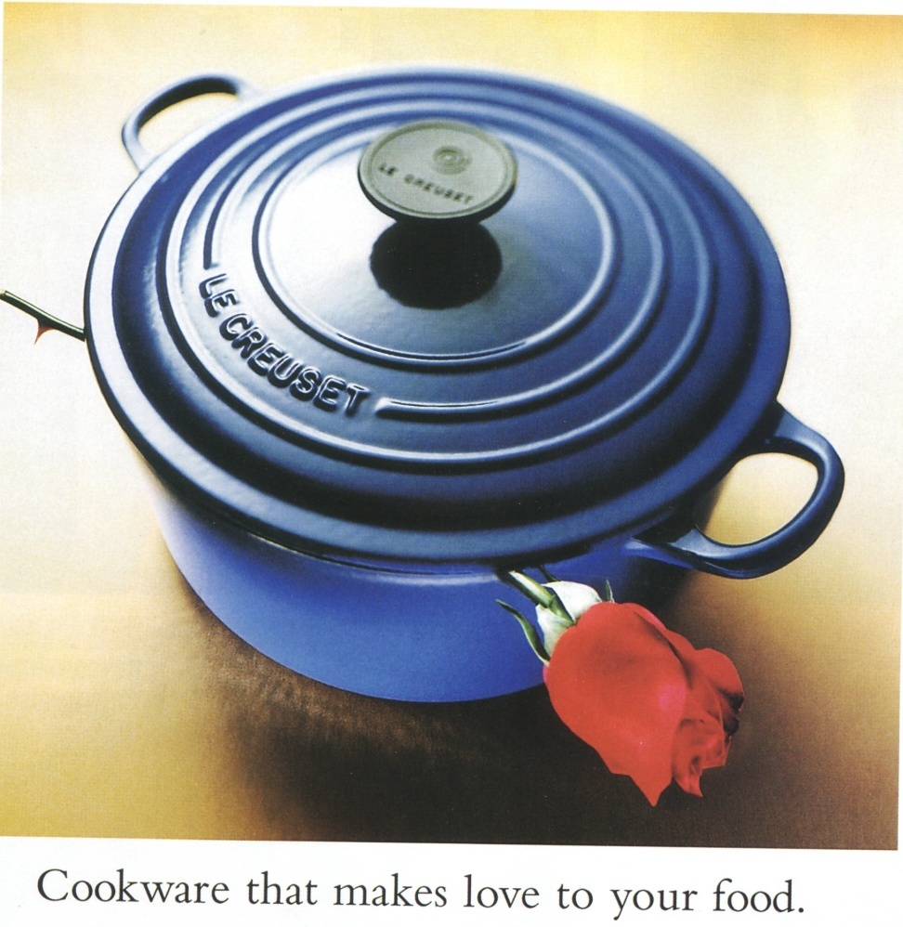

Symbolic Codes: Props and Setting What meanings do theses carry for the audience?
Objects
Places

Slide 5
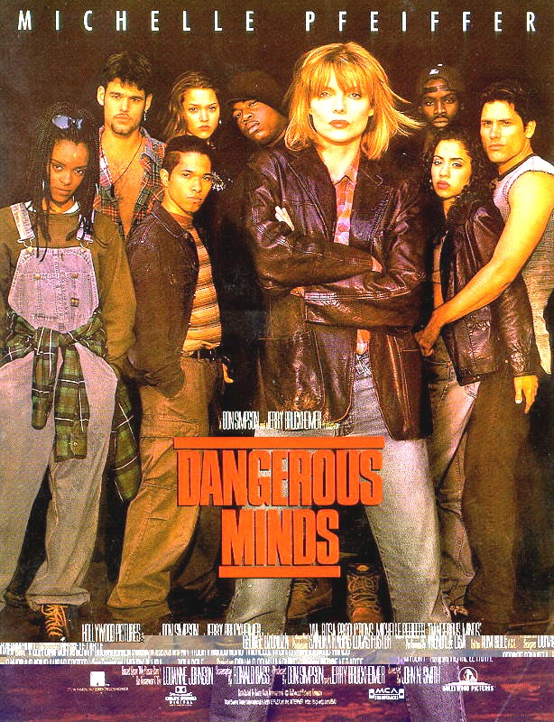
What can we read from the
Symbolic Code: People/actors
Gaze
Stance
Clothing
Appearance
Facial expression
Hands / Gestures
Proximity and location
Bodily contact

Slide 6
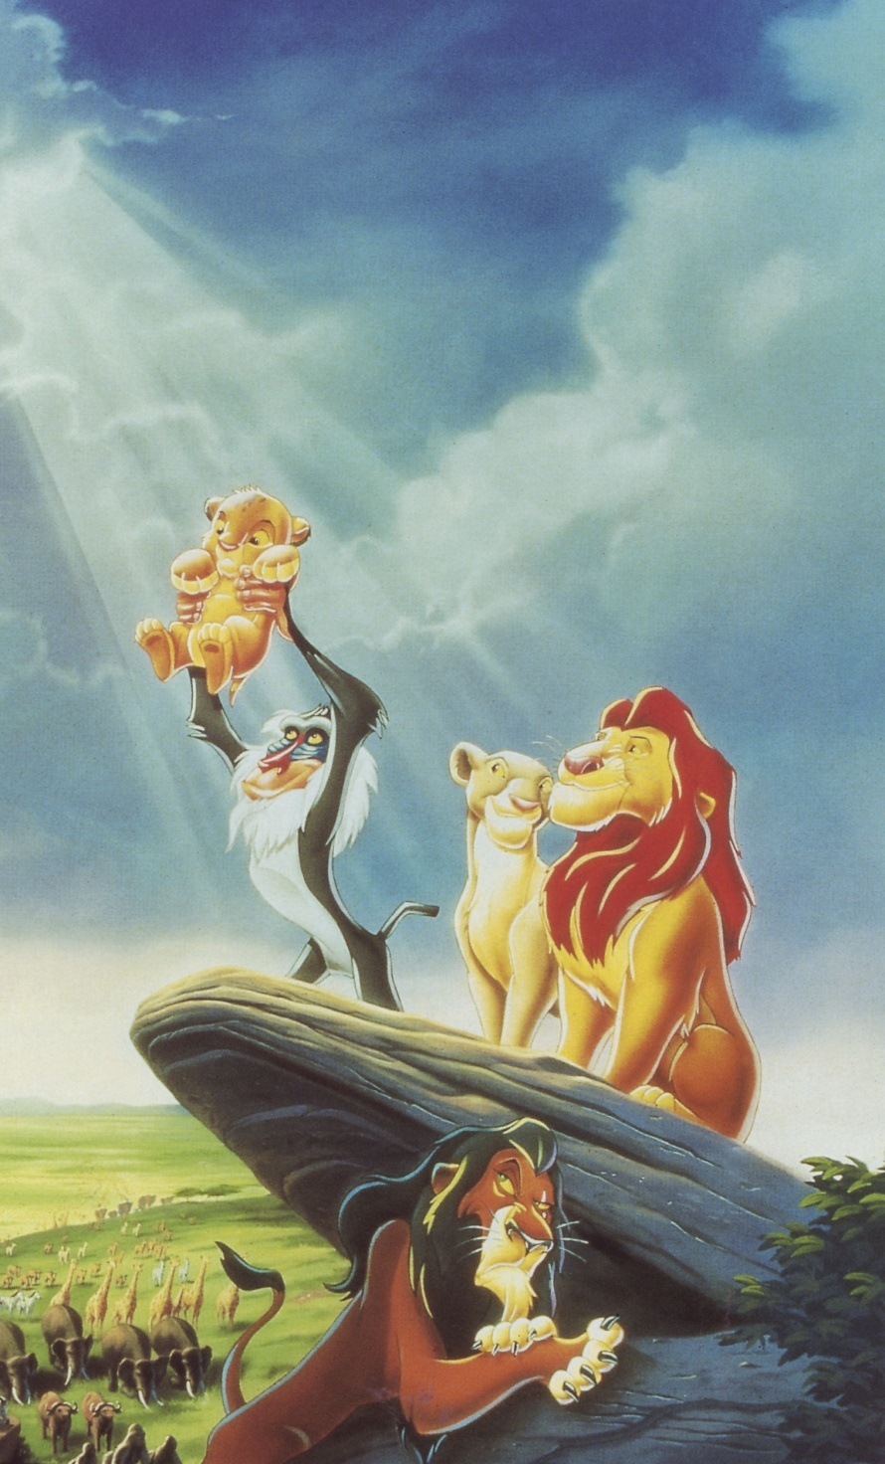
The choice made about the way an image is shot also communicates meanings
Technical Codes:
Framing
Camera work: distance / shot type, movement, angle
Lighting and colour
Leading lines

Slide 7

You then need to consider how all this is put together as this tells us even more.
Construction:
Composition – what is placed where? Consider: what is centred, foregrounded and what is in background or marginalised

Slide 8
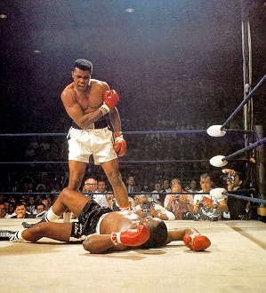
You can apply well known ways of reading an image: e.g. Rule of Thirds, but use them sparingly (I would say never but hey…!) and only if you are talking effect and levels of meaning.

Slide 9
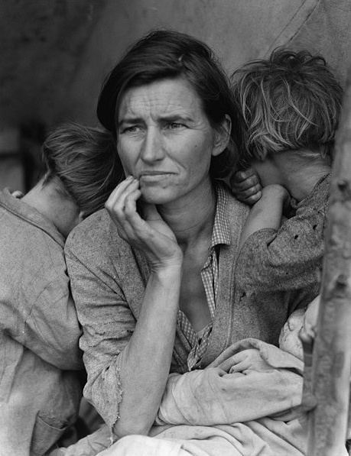
Looking at composition is best way in:
How are the elements within the image placed?
Where do the leading lines draw your eye?
Many images follow similar patterns – it’s a convention applied by producers because they can predict the effect.

Slide 10
Genre
What genre is it?
What does that tell you about purpose and audience?
What do you expect to see? – Conventions.
How can you use your prior knowledge of genre in your response?

Slide 11


Same genre?

Slide 12
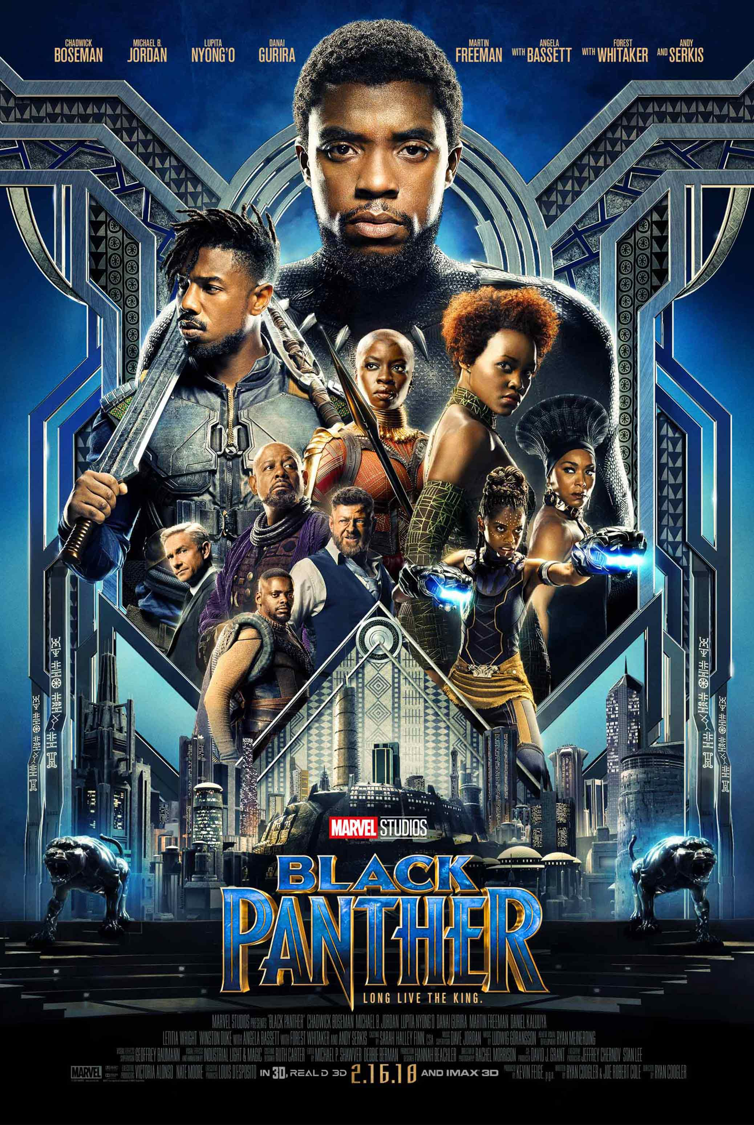

Genre, audience, purpose?

Slide 13

Targeting audiences

Slide 14
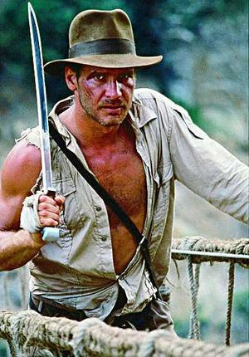
Meanings
Images convey ideas about the overt content (denotation)
Images convey ideas on an ideological/cultural level (connotation)

Slide 15
Images, Ideology and Representation
Images can reflect and reinforce dominant ideologies by representing groups in the same way over and over again
i.e. by associating certain ideas with the group through the repeated use of visual elements with accepted meanings

Slide 16
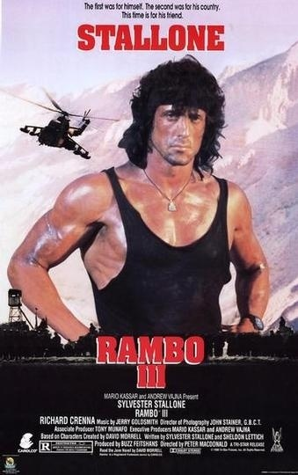
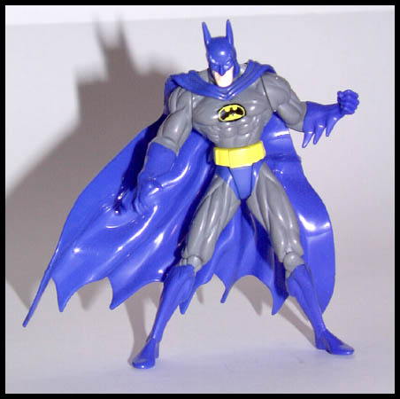
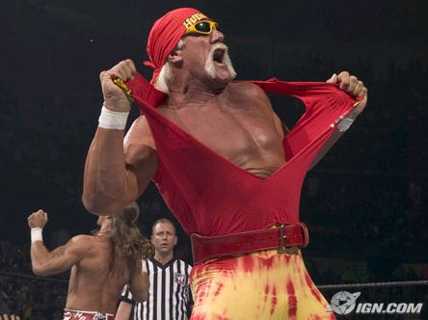


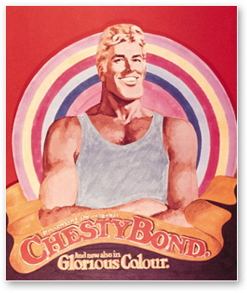
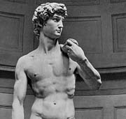
Repeating representation = naturalised ideas

Slide 17
Naturalised ideas
Images can challenge or subvert dominant ideologies / naturalised ideas by representing groups / places in new ways
i.e. by transgressing the accepted conventions of representation
by associating certain ideas with the group/place through the use of visual language not normally associated with the group

Slide 18
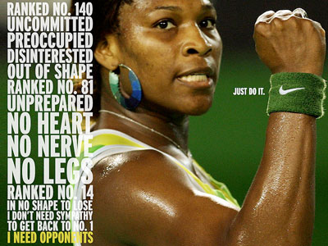

Slide 19
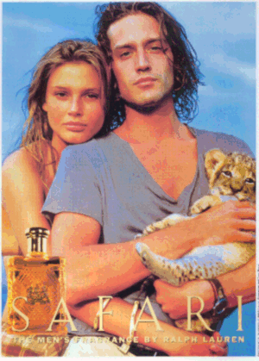
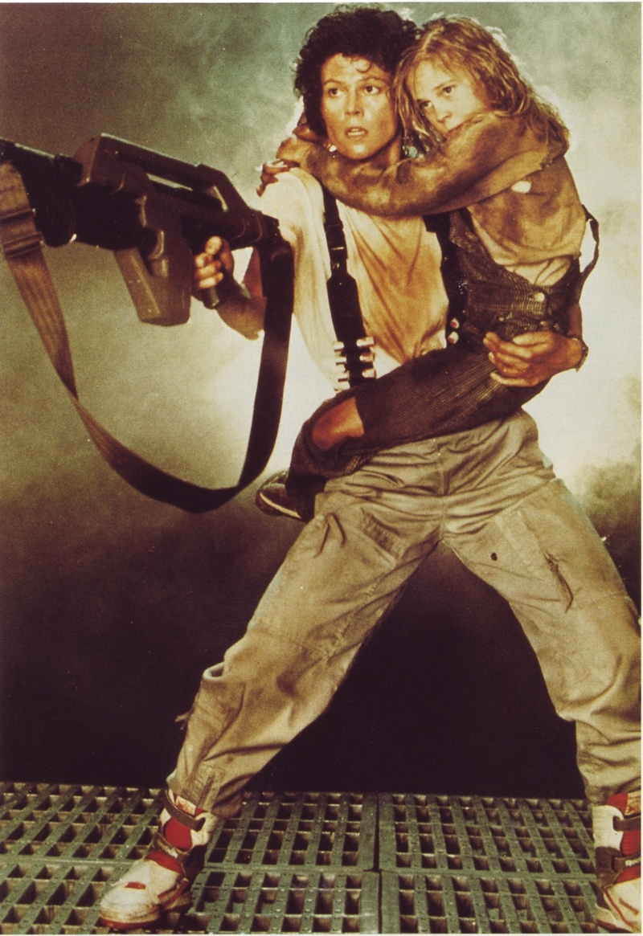
Images can also reinforce and challenge or subvert dominant ideologies at the same time

Slide 20
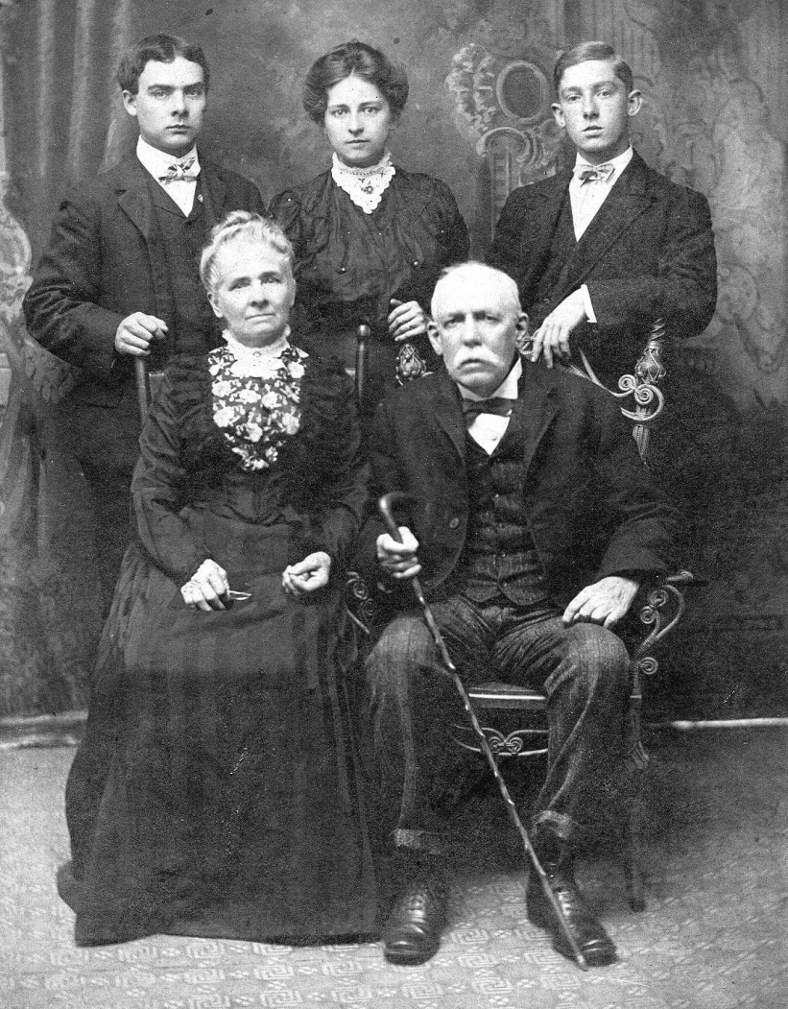
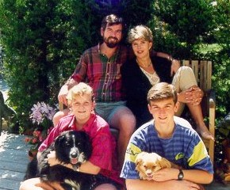
Context
Whether images reinforce or challenges dominant ideas depends on context – i.e. the beliefs, attitudes and values (ways of thinking) of the society in which it is read

Slide 21
Ideology Again
Don’t just get stuck on gender - there are other discourses which tell us stories and reflect ways of thinking (ideological positions) about:
Families
Violence
Nature
The City
War
Science
Home etc.

Slide 22
Strategy
Thesis: Read the image as a representation of …family, conflict, gender, violence etc. (x as y) WHAT
2 Paragraphs explaining how ideas are conveyed through visual language (composition, gaze/stance and setting/symbols are good places to start) or focusing on different codes ( x as y via z1 and z2) or (x as y1 and y2 via z) HOW
Add sophistication - Zoom out to bigger picture/context:
Look at ideas being expressed by the image – do these reinforce or challenge dominant ideas? (taking into account Genre and context) SO WHAT?
Brief comment linking to bigger picture (conventions, genre or society) In your thesis or concluding sentence.) e.g. ‘This image challenges typical representations of the happy united family by representing a family as divided and unhappy.’

